Slide 1

My Idol Researcher

Slide 2
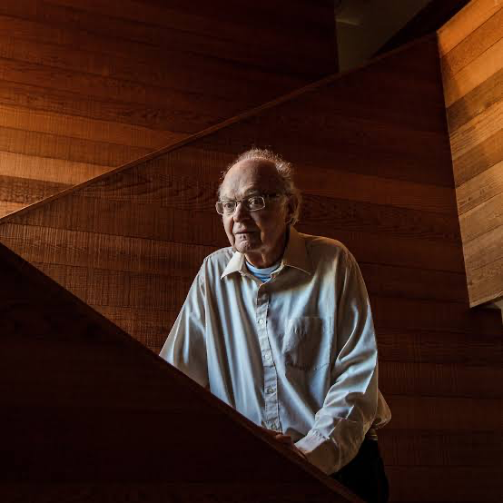
Donald E. Knuth
Author : The Art of Computer Programming
Recipient : Turing Award, Algorithm Analysis
Recipient : National Medal of Science
Recipient : John von neumann medal
Recipient : Kyoto prize

Slide 3
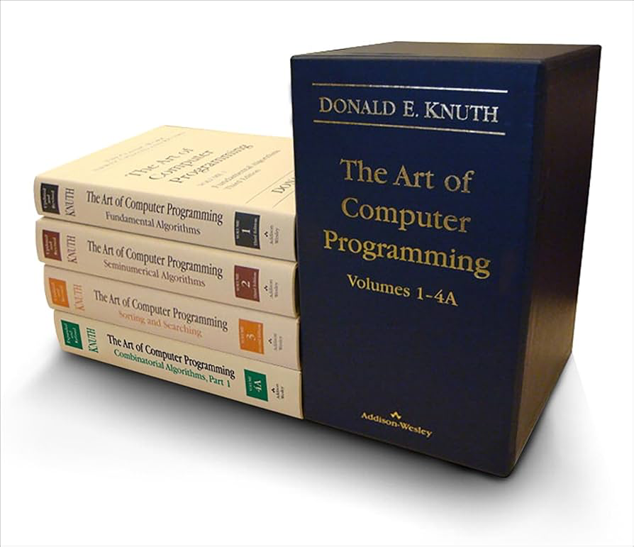
The Art of Computer Programming
Core algorithms and data structures; deep analysis that uncovers the elegant foundations of programming

Slide 4
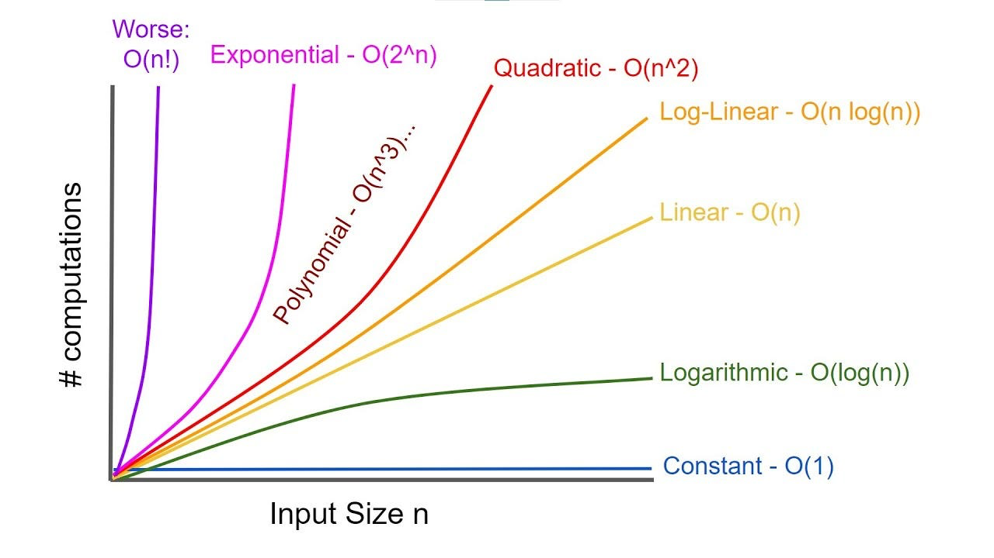
Analysis of Algorithm

Slide 5
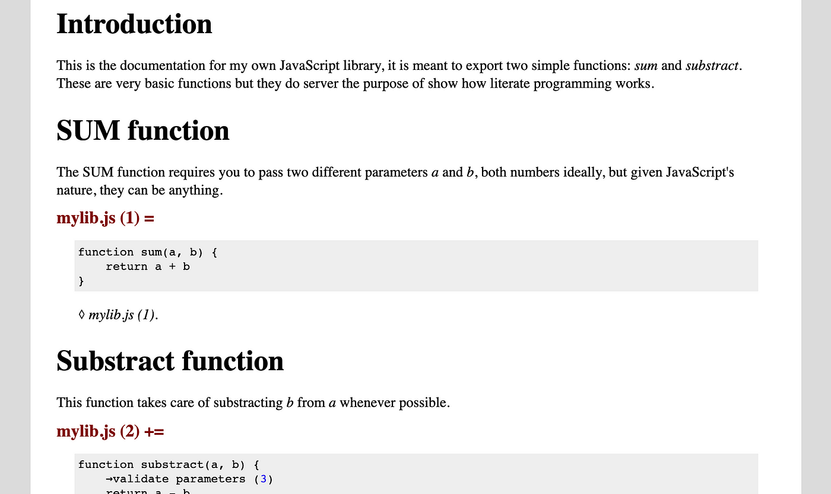

Literate Programming : Methodology that combine Code with Documentation

Slide 6
What is Research?

Slide 7
What is Research?
Research is a systematic process used to deeply explore a specific topic or area. The goal is to either question existing ideas or discover something new that might be useful in the future.

Slide 8
Types of research
Fundamental : aims to expand general knowledge and understanding without focusing on practical applications.
Applied : focuses on solving specific, practical problems using scientific methods.
Quantitative : research involves the collection and analysis of numerical data to identify patterns, relationships, or trends.
Qualitative : explores non-numerical data to understand experiences, behaviors, and social phenomena in depth.

Slide 9
What I have learned from the speaker

Slide 10
What I have learned from the speaker
ความรู้ในสายคอมพิวเตอร์ จำเป็นต้องเรียนรู้สิ่งใหม่ ๆ อยู่เสมอ เนื่องจากมีเทคโนโลยีใหม่ ๆ เกิดขึ้นทุกวัน
เราไม่ควรเลือกหัวข้อวิจัยถ้าเราไม่มีความรู้และความสนใจในด้านนั้น

Slide 11


